Slide 1
Warehouse Management API
Made by:
Nenad Saldziev ID: 5100
Khalid Nushevik ID: 4916

Slide 2
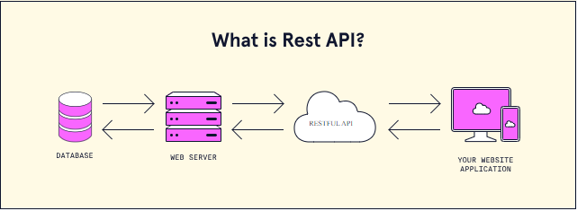
API
API stands for Application Interface Programming.
This is just an Interface that we can use it.
This API is needed and used to make a contact between the server and the two applications:
That is The program and the web page.

Slide 3




How do we use this?
First we need 3 things:
The Server that we need to collect data into a database (Ex: PostgreSQL (pgAdmin 4 or Docker)).
The program we are making (Ex: Java (Spring Boot)).
The Application that we need to input the information or data (Ex: Postman).

Slide 4
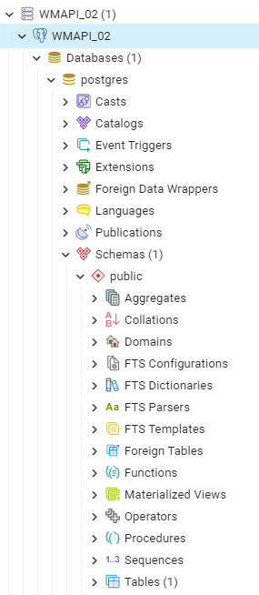
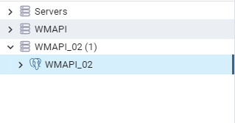
How do we do this?
First we make the database that is on PostgreSQL
Then we create a Table that we need to input the data.
Save and let the Database be active.

Slide 5
We start Programming
We will create a Spring boot tool to make our application quick and easy.
In the application we will add the additional libraries that come with the tool.
Then we need to create the class for each data that we created in the PostgreSQL database.
Then Create a interface that we use as a repository in our program.
To need to control all the given information we create a class that we use to get the input in the given application that is Postman.
That is a CRUD and stands for Create, Read, Update and Delete.

Slide 6
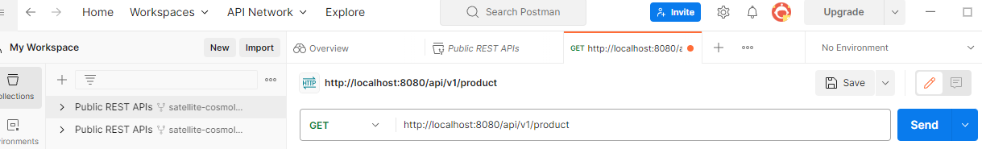
How to use the postman?
We use the postman as a access to the given database so that we can see all the data or specific data that we are needed.
We can also add new data, delete data and Update the data given.e

Slide 7
To work with…
We first need to activate the database then the program that we made thanks to Java Spring Boot so that we need to activated and to access it we use the postman application that we have.

Slide 8
Any Questions

